Slide 1

CUSTOMER ORDER & SALES ANALYTICS SYSTEM
DATABASE DEVELOPMENT WITH PL/SQL
Student: Benjamin Niyongira
ID: 27883 | Group: Thursday
Course: INSY 8311
Lecturer: Eric Maniraquha
AUCA | December 2025

Slide 2
Problem & Objectives
PROBLEM STATEMENT:
PROJECT OBJECTIVES:
Businesses struggle with tracking customer orders
1
Automate order processing system
No real-time sales analysis capabilities
Manual inventory management
2
Provide real-time sales dashboards
Lack of customer insights
TARGET USERS:
3
Implement inventory optimization
Sales Managers
Inventory Managers
4
Enable customer behavior analysis
Executives
Customer Service
5
Ensure data integrity with business rules

Slide 3
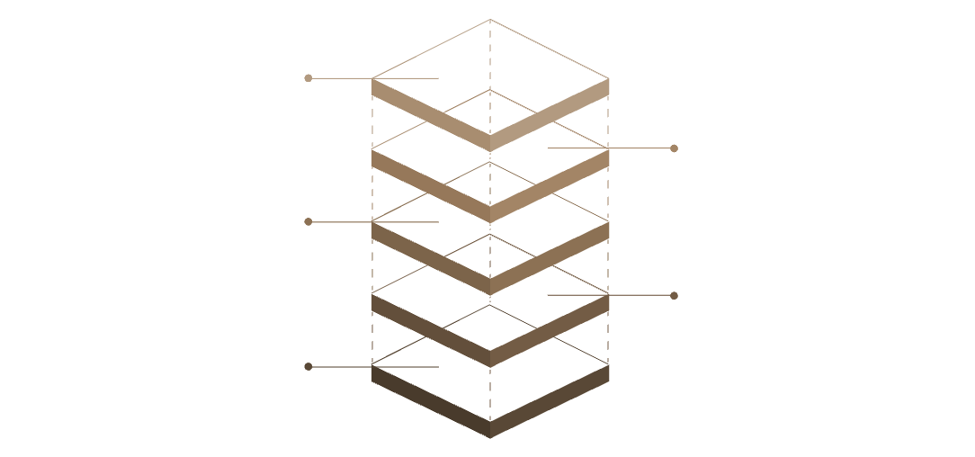

Technology & System Overview
TECHNOLOGY STACK:
KEY FEATURES:
Database: Oracle 19c
12 Normalized Tables (3NF)
Language: PL/SQL
5 PL/SQL Procedures
Tools: SQL Developer, GitHub
6 PL/SQL Functions
Platform: Windows
4 Database Triggers
SYSTEM COMPONENTS:
Comprehensive Audit System
Audit & Security
Log changes and enforce access control
Analytics & Reporting
Generate system reports and metrics
Inventory Management
Track stock levels and movements
Order Processing
Handle order lifecycle and transactions
Customer Management
Manage customer records and profiles

Slide 4
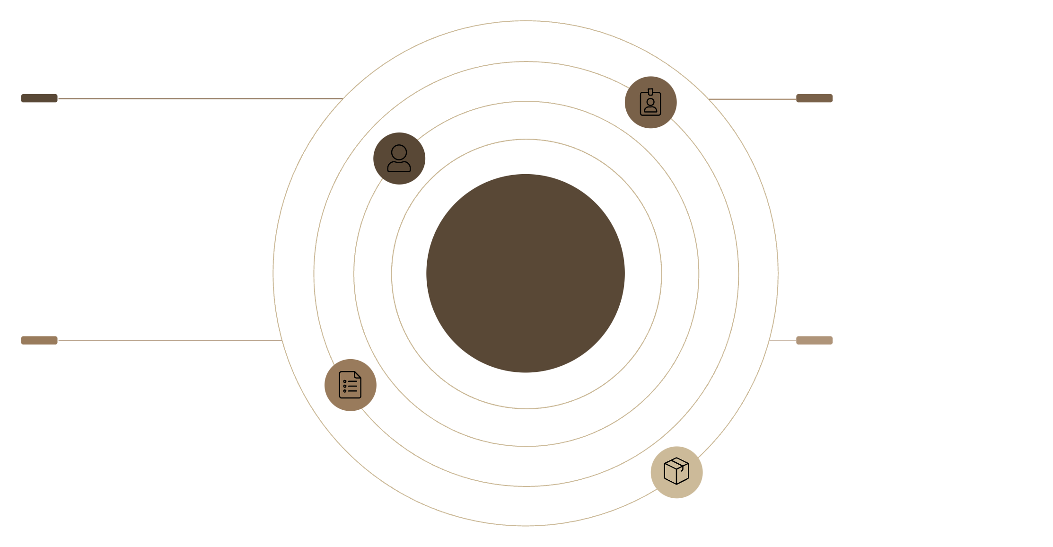

ER Diagram & Additional Tables
Customers → Orders
Employees → Orders
Customers place one-or-more orders
Employees handle and process orders
Core ER Diagram Overview
Orders ↔ Order_Items
Products relations
↔
Products link to categories and suppliers
Orders composed of multiple order items
ADDITIONAL TABLES:
AUDIT_LOG - Complete operation tracking
HOLIDAYS - Business rule enforcement
EMPLOYEE_RESTRICTIONS - Access control
BUSINESS_RULE_VIOLATIONS – Compliance

Slide 5
Procedures, Functions & Advanced Features
PROCEDURES IMPLEMENTED:
ADVANCED FEATURES:
ADD_NEW_ORDER - Creates orders with validation
UPDATE_ORDER_STATUS - Manages order lifecycle
Window Functions
PROCESS_PAYMENT - Handles financial transactions
(ROW_NUMBER, RANK, LAG)
GENERATE_SALES_REPORT - Analytical reporting
UPDATE_CUSTOMER_TIER - Loyalty program management
Bulk Operations
FUNCTIONS IMPLEMENTED:
(BULK COLLECT, FORALL)
calculate_customer_discount()
get_product_profit_margin()
validate_email()
Cursors
get_customer_order_summary()
(Explicit & Parameterized)
check_stock_availability()
Exception Handling

Slide 6

Critical Business Rule & Audit System
CRITICAL BUSINESS RULE:
Employees CANNOT perform INSERT/UPDATE/DELETE on:
WEEKDAYS (Monday-Friday)
PUBLIC HOLIDAYS (from holidays table)
IMPLEMENTATION:
AUDIT SYSTEM:
check_if_weekday() - Date validation function
Complete operation logging
check_if_holiday() - Holiday verification
Success/failure tracking
check_employee_restriction() - Main validation
User/IP address recording
4 Database Triggers for enforcement
Error message storage
TRIGGERS CREATED:
orders_before_insert_restriction
orders_before_update_restriction
orders_before_delete_restriction
orders_compound_audit_trigger

Slide 7
Testing Methodology & Results
TESTING METHODOLOGY:
TEST RESULTS:
Unit Testing - Individual components
✅ All tables created successfully
Integration Testing - System workflow
✅ 150+ customers, 300+ orders inserted
Business Rule Testing - Restriction validation
✅ Procedures & functions compiled without errors
Performance Testing - Query optimization
✅ Triggers correctly block/allow operations
VALIDATION QUERIES:
✅ Audit log captures all activities
✅ Foreign key constraints enforced
Constraint verification
✅ Data integrity maintained
Relationship validation
Data consistency checks
Performance benchmarking

Slide 8
Key Performance Indicators
SALES METRICS:
CUSTOMER METRICS:
Total Revenue: SUM of all delivered orders
Customer Acquisition Cost
Monthly Growth: LAG() window function
Retention Rate
Average Order Value: Revenue / Order Count
Tier Distribution Analysis
Customer Lifetime Value: Total spent per customer
Purchase Frequency
INVENTORY METRICS:
ANALYTICAL QUERIES:
Stock Turnover Ratio: Sales / Average Inventory
Customer segmentation (NTILE, RANK)
Days of Inventory: Stock / Daily sales average
Sales trend analysis (LAG, LEAD)
Low Stock Alerts: Automatic reorder notifications
Product performance ranking
Seasonal pattern identification

Slide 9
Data Volume & Performance
DATA VOLUME ACHIEVED:
PERFORMANCE RESULTS:
Customers: 150+ records
Indexes: 20+ performance indexes created
Products: 200+ items
Query Optimization: Window functions implemented
Orders: 300+ transactions
Bulk Operations: BULK COLLECT for efficiency
Order Items: 800+ line items
Response Time: Sub-second for key queries
Payments: 400+ transactions
BUSINESS RULE VERIFICATION:
Audit Log: 1000+ entries
✓ Weekday restrictions: ENFORCED
GITHUB ORGANIZATION:
✓ Holiday restrictions: ENFORCED
8 Phases completed
✓ Audit trail: COMPLETE
50+ SQL files
✓ Data integrity: MAINTAINED
Complete documentation
✓ Error handling: COMPREHENSIVE
Screenshot evidence

Slide 10
Achievements & Future Enhancements
ACHIEVEMENTS:
LESSONS LEARNED:
Complete production-ready database system
Importance of proper database design
Real-time order processing with validation
Value of comprehensive testing
Comprehensive sales analytics capabilities
Benefits of modular PL/SQL development
Robust business rule enforcement
Need for clear documentation
Full audit trail for compliance
Critical role of business rules
TECHNICAL SKILLS DEMONSTRATED:
FUTURE ENHANCEMENTS:
Oracle Database Design & Implementation
Real-time dashboard integration
Advanced PL/SQL Programming
Machine learning for sales forecasting
Business Rule Implementation
Mobile application interface
Performance Optimization
Advanced security features
Documentation & Version Control
Cloud migration
THANK YOU & Q&A

